Slide 2
Tools and Pre-Workshop Steps
Have a method of RDPing to a remote server
Be connected to the event WiFi (Internet is required)
https://aka.ms/vdcTraining (Company Roster) to get your company number
Log into the Azure Portal to your Resource Group (subscription “vDC Workshop”)
Open Key Vault for Username and Password for all servers (e.g. Company04User secret)
RDP and log in to your on-prem server
Once on your “on-premises” server, install Azure PowerShell SDK with an Admin PowerShell
Set-ExecutionPolicy -ExecutionPolicy RemoteSigned
Install-Module AzureRM
http://aka.ms/vdcWorkshop download as zip (or clone if you’re GIT friendly)
gci -Path 'C:\Bin\vdcWorkshop' -Recurse | Unblock-File (Change path to match your dir)

Slide 3
Hands-on creating a Virtual Data Center
PRE24
Jon Ormond, Azure Networking
Jared Ross, Azure Networking
Anavi Nahar, Azure Networking

Slide 4
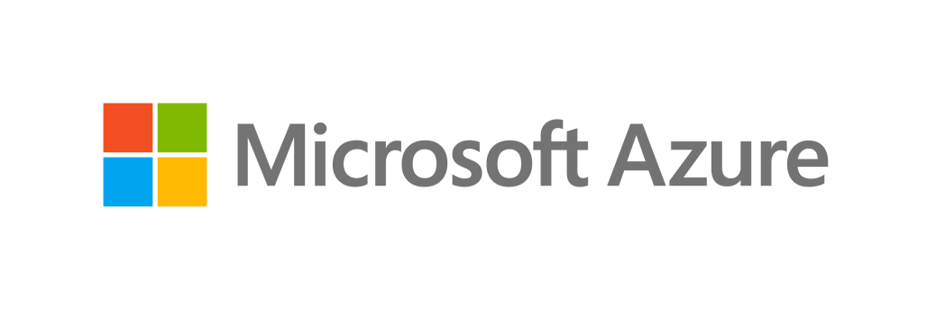
Azure Networking Services
App Gateway
Protect
Virtual WAN
Connect
Deliver
Monitor
ExpressRoute
Traffic Manager
HA Port LB
UDR
VPN
Load Balancer
DNS
CDN
Virtual Network
Firewall
Azure Monitor
NSGs
Network Watcher
DDoS Protection
VNet Endpoints
Virtual Appliances
WAF

Slide 5
Workshop Objective

Slide 6
Step One – Create VNet

Slide 7



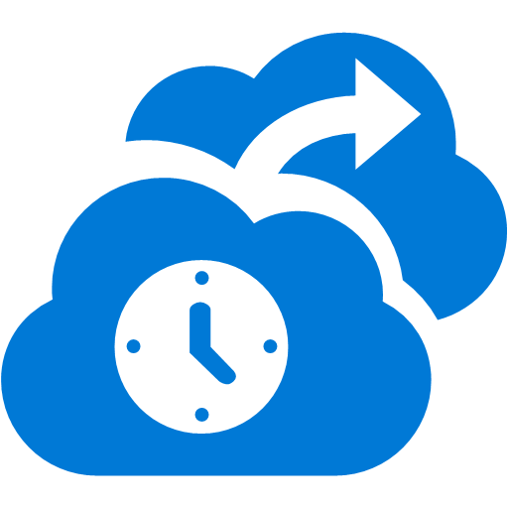



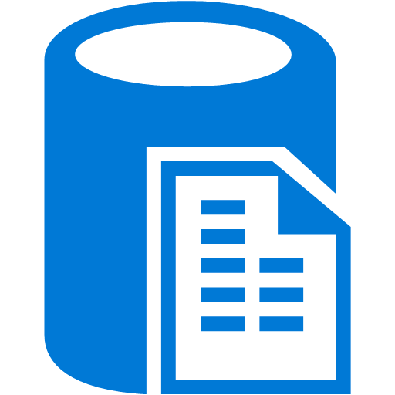


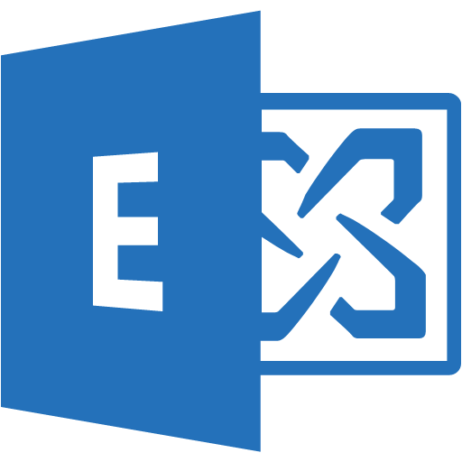
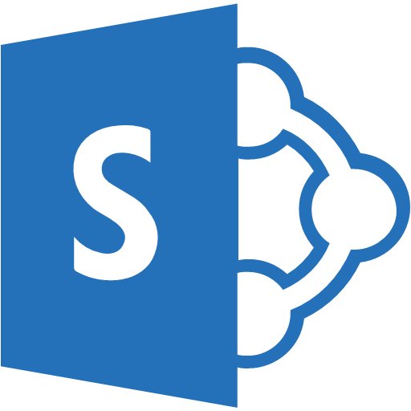



ExpressRoute
✔ Unified connectivity to Microsoft Cloud Services
✔ Predictable performance
✔ Enterprise-grade resiliency and with SLA for availability
✔ Large and growing ExpressRoute partner ecosystem
Microsoft Peering for Office 365, Dynamics 365, Azure Public IPs
ExpressRoute Circuit
Customer’s Network
Primary Connection
Partner Edge
Microsoft Edge
Primary Connection
Microsoft Peering for Office 365, Dynamics 365, Azure public services (public IPs)
Azure Private Peering for Virtual Networks
Azure Private Peering for Virtual Networks

Slide 8
Step Two – Create ExpressRoute and Provision
Validation:
Log into Azure Portal
Copy ExpressRoute Service Key to http://aka.ms/WorkshopSP

Slide 9
Step Three – Create ER Gateway and Connection
Validation:
Log into Azure Portal
Look at ExpressRoute Private Route table

Slide 10
Step Four – Create VM, Test Connectivity
Validation:
1) RDP to On-Premises, Ping Test VM
2) Get Test VM Public IP, RDP to Test VM

Slide 11
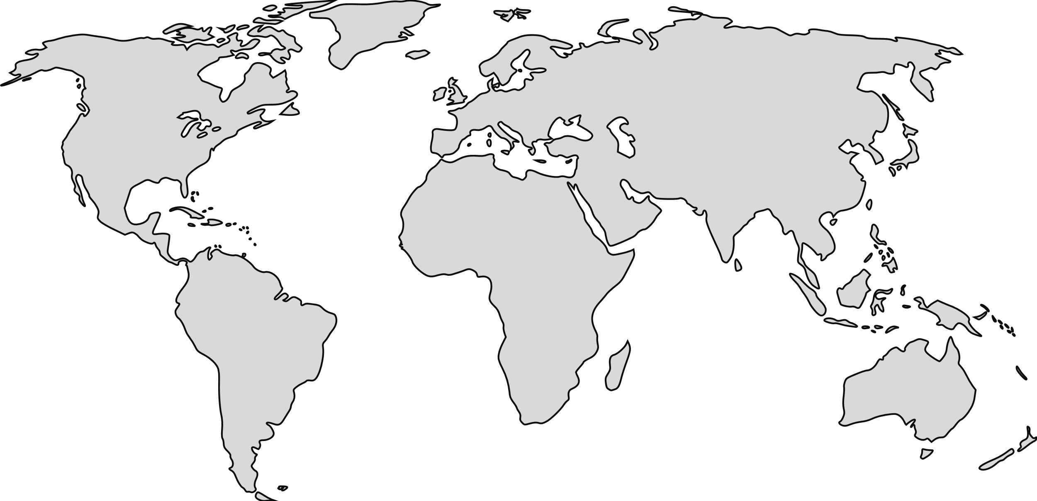
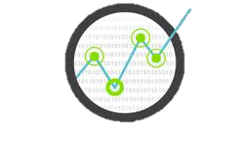



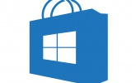
Azure DDoS Defense
Designed into the global network​
​
Global distribution of attack traffic during large scale attacks​
25+ Tbps global mitigation capacity
​
Continuous monitoring, learning, and protection signature improvements​
​
Proven defense for Microsoft services ​
​
Specifically tuned protection for your app​
​
Active traffic monitoring to proactively detect emerging threats and attack vectors
Traffic Monitoring
Emerging attack patterns
54 Azure Regions
DDoS Protection
Azure Regions
DDoS Protection
Massive attacks defended
Per-App Dynamic Mitigation Policies
Virtual Network Your applications
Azure Host
VFP

Slide 12


Standard Load Balancer
Inbound
Outbound
Deploy high performance, scale, and flexibility in all your network load-balancing scenarios
Health
Probe
AZ1
AZ2
Built-in High-Availability and Performance
Inbound and Outbound
Public and Internal
Availability Zones
Flexible for all TCP or UDP applications
Any VM in a VNet
HA Ports rules for n-active resiliency
Health model for TCP, HTTP, and HTTPS
Telemetry in Azure Monitor
Multi-dimensional metrics
3rd party integration
IP
IP Prefix
VMSS
VMSS
VNet
Pool
Configure SNAT ports per VM
VNet
HA Ports for Appliances
VNet

Slide 13
Step Five – Create Spoke01: VNet, VMSS, File Server
Validation:
Get Load Balancer IP
RDP to On-Prem
Open File Explorer
Browse to:
\\<LB IP>\WebShare

Slide 14
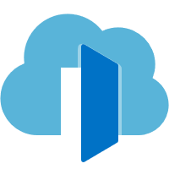

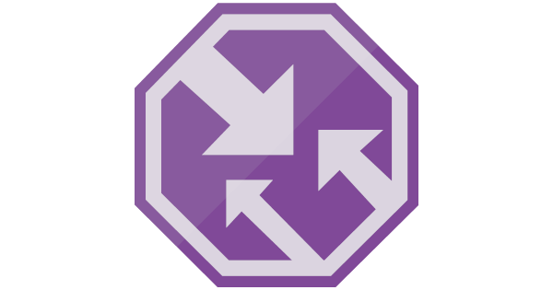
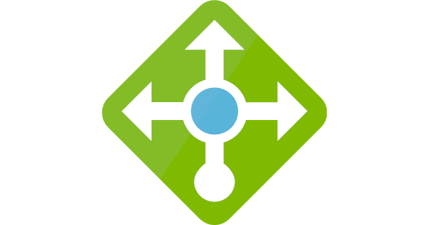



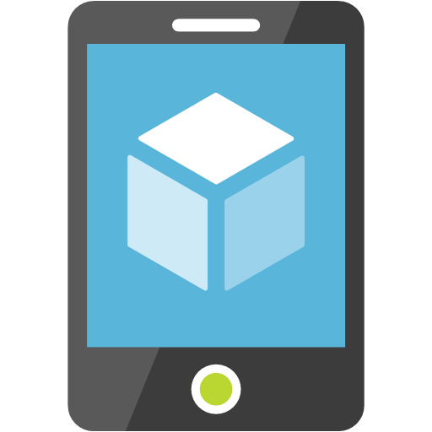
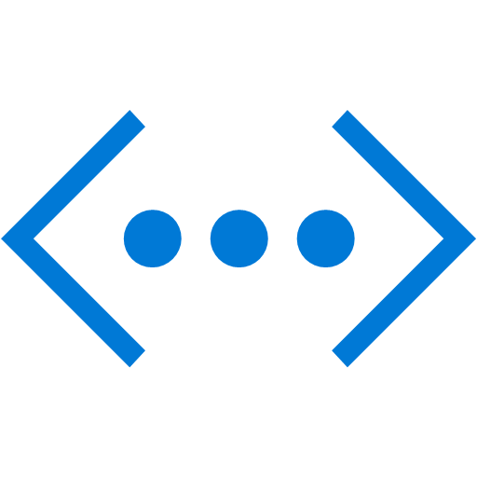
Load balancing in Azure’s application delivery suite
Preview
Application Gateway
Front Door
Traffic Manager
Standard Load Balancer
(Public)
Standard
Load Balancer (Internal)
Global
Region / Zone
Global
Regional / Zonal
VNET
Route to your closest available service region or your on-prem DC. Offload SSL, improve performance / accelerate websites at the Edge.
Route across zones and into your VNET. Offload SSL and build your application-specific logic.
Route across and between your resources to build your regional application.

Slide 15


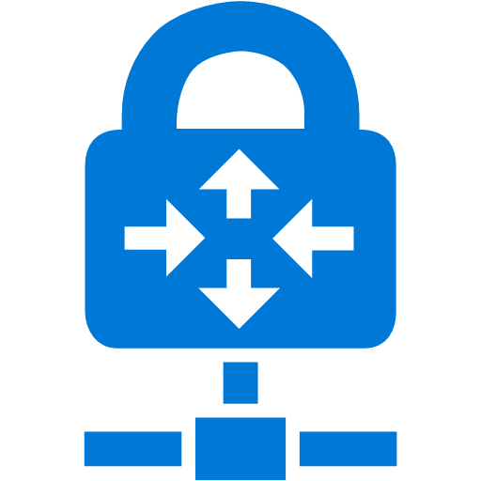
Application Gateway
Application Delivery Controller as a service
Layer 7 Load balancing and SSL management
Built in highly availability and scalability
Centralized SSL offload and SSL policy
Public and Internal
Layer 7 routing – URL path, host based, round robin, cookie based affinity, redirection
New capabilities
Connection draining support
Custom error pages
Enhanced multi dimensional metrics
Integration with Network Watcher
Portal enhancements – SSL policy, VMSS, Web App Services, Custom error pages, Redirection, Connection draining
Web App Service
Site 1
Internet
Application Gateway
Site 2
VPN
On-Premises

Slide 16
Step Six – Create Spoke 2: App Gateway, IIS Servers
Validation:
Get IIS 1 private IP
RDP to On-Prem
Open browser
Browse to:
http://<IIS 1 IP>
Note: you’ll get a path not accessible type error, if you get a 404, the validation is a failure

Slide 17
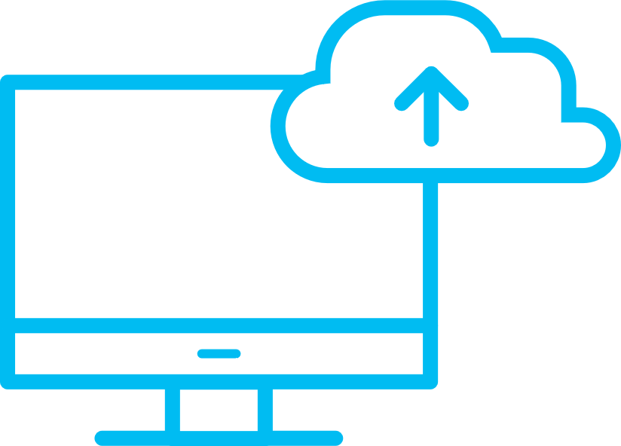
Microsoft Confidential
Azure DNS – Host DNS Zones with High Availability
Our 100% SLA will help meet your reliability and resiliency requirements
0:00
Protect Against Zero Day vulnerabilities
Reliability via Global anycast network
By having completely independent technologies and diverse technology stacks on the data plane gives 100% protection against Zero day exploits.
Multiple nodes around the world advertise a given IP address providing reliable responses even in event of a node failure.
Announcing DNS Alias records
Keep your DNS records automatically updated when IPs change for your ARM resources
Prevent outages or undesirable redirection of traffic for your applications when IPs are removed/changed
Run a load balanced application directly at your Zone Apex by Alias to Traffic Manager

Slide 18
Azure Firewall
GA
L3-L7 Connectivity Policies
Configure firewall rules for all your resources with network and application level filtering
Spoke 1
NAT, Network and Application traffic filtering rules allows Inbound/Outbound access
Cloud native stateful Firewall as a Service
Built-in High Availability and Auto Scale
Network and Application traffic filtering
Centralized policy across VNets and Subscriptions
Complete VNET protection
Filter Outbound, Inbound, Spoke-Spoke & Hybrid Connections traffic (VPN and ExpressRoute)
Centralized logging
Archive logs to a storage account, stream events to your Event Hub, or send them to Log Analytics or SIEM
Central
VNet
Spoke2
Spoke VNets
Azure to On-Prem traffic filtering
Traffic is denied by default
On-Premises
Notes:
; SNAT and DNAT
FQDN Tags support (e.g. Windows Update, ASE)
Deployed in a click; fully integrated with the Azure Platform

Slide 19
Step Seven – Create NVA Firewall, Set UDR Rules
Validation:
Get AppGw public IP
Open browser
Browse to:
http://<AppGW IP>

Slide 20
Step Eight – Create Remote VNet, connect to ER
Validation:
Get Remote VM Private IP
RDP to On-Prem
Ping Remote VM IP

Slide 21

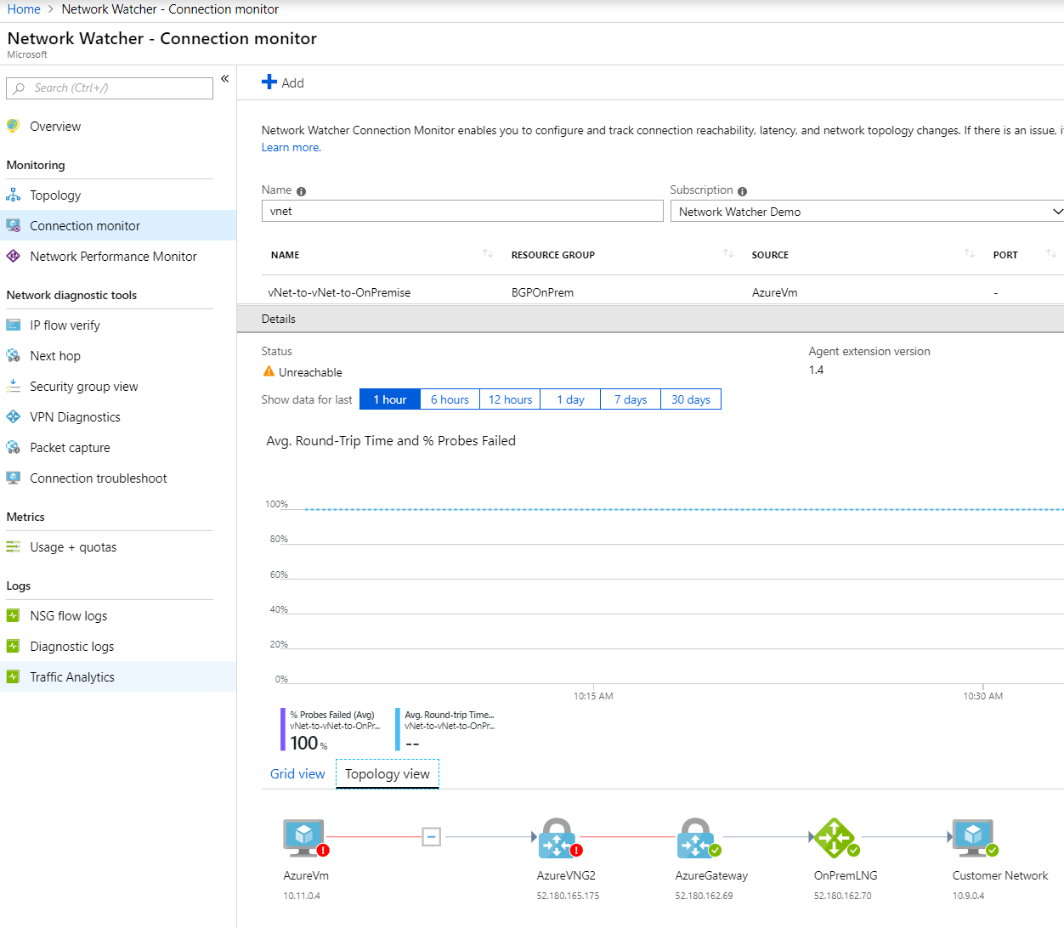
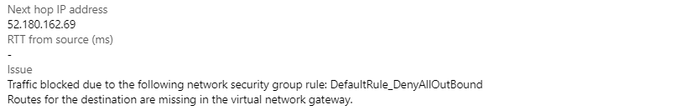
Network Watcher
Unified and Integrated Network Monitoring experience
Connection Monitor and Troubleshoot now integrated with VNet, VM, Application Gateway, Azure Firewall and Azure WAN
Multi-Subscription single storage support for NSG Flow logs
NSG Flow logs support for Classic NSG resources
Network Performance Monitor (NPM) available from Network Watcher
Improved Traffic Analytics processing time (10 min)

Slide 22


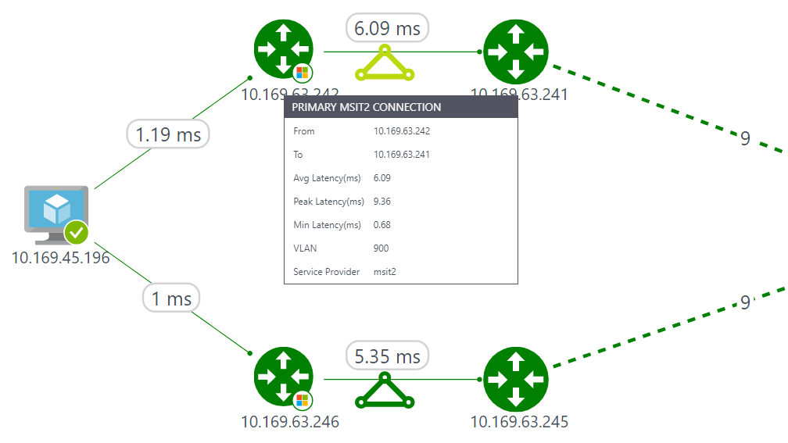


Network Performance Monitor
Monitor your hybrid network
Single solution for your hybrid network
E2E monitoring of ExpressRoute, application and network connectivity.
Network Performance
Real time monitoring of network performance, availability and utilization. Auto discovery of network topology. Faster fault isolation.
Real-time alerts
Intelligent, threshold based alerts.
Analytics and Correlation
Detect transient network issues.
Analyze historical network performance characteristics.

Slide 23
Step Nine – Network Monitoring

Slide 24
Notes (hidden)
Some speakers at Microsoft like to use this slide for hidden “notes slides”.
Delete it if you don’t want to use it.
NEXT: <next slide title>

Slide 25
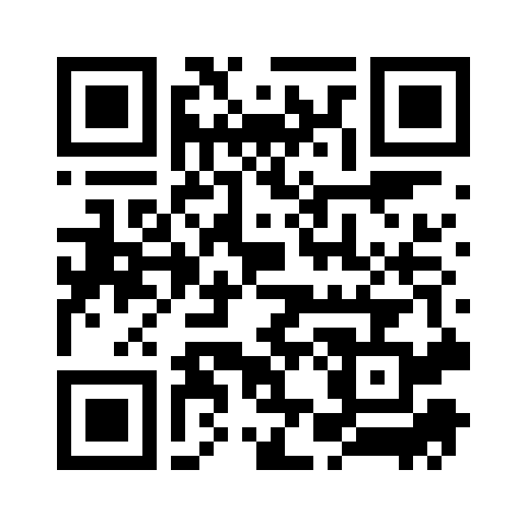
Please evaluate this session Your feedback is important to us!
This slide is required. Do NOT delete or alter the slide.
The slide will be replaced onsite through Silver Fox Productions with an updated QR code.
From your PC or Tablet visit MyIgnite at http://myignite.microsoft.com
From your phone download and use the Ignite Mobile App by scanning the QR code above or visiting https://aka.ms/ignite.mobileapp

